Slide 1
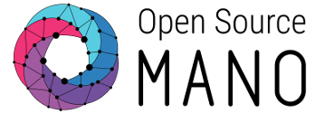
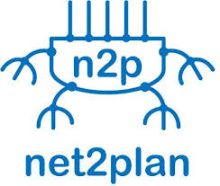
OFC Demo Proposal
Joint Optimal Service Chaining allocation, VNF instantiation and Metro network resource allocation with OSM, Net2Plan and Netphony.
F.J. Moreno-Muro, C. San-Nicolas-Martinez, E. Martin-Seoane, M. Garrich, P. Pavon-Marino, O. Gonzalez de Dios, V. López
Netphony

Slide 2



Network Scenario & Goals
Metro-Haul Network:
Interconnected Metro edge and Metro core nodes
Edge DC and regional DC attached to edge & core nodes
Goal:
Proof of concept of the use of a specialized planning tool using service-chain-based algorithms to assist NFV-O and T-SDN in the optimal VNF placement and optimization of transport network
Demonstrate the interaction of well-known ETSI OSM NFV orchestration suite and open-source Net2Plan planning tool.
Demonstrate the use of standard Topology interfaces to provide detailed multi-layer topological information the planning tool
EDGE
DC
EDGE
DC
NFVI
Compute
Domain
NFVI
Compute
Domain
Metro Edge Node
Metro Edge Node
EDGE
DC
NFVI
Compute
Domain
REGIONAL
DC
NFVI
Compute
Domain
Metro
Node
Metro Edge Node
Metro Node

Slide 3
Demo setup
12/11/2017
3

Slide 4
Interfaces Involved in the demo
NFV-O – Planning Tool
NFV-O -> Planning tool: Detailed info of compute nodes and usage
NFV-O -> Planning tool: connectivity of Compute intrastructure to transport network
NFV-O -> Planning tool: request of VNF placement
Planning tool – NFV-O: VNF placement info.
T-SDN (Nephony) – Planning Tool (Net2Plan)
Detailed Native topology from T-SDN to Planning Tool
Suggestions of topology modifications from Planning Tool to T-SDN (allocate network resources)
Performance data (e.g. Traffic)
NVFO – T-SDN ?
T-SDN -> NFV-O : Abastracted Transport network topology

Slide 5
Workflow
TBD

